Slide 1

Preparation before class
preparation before class
Offline programming
Yahboom Croco:Kit tutorial

Slide 2
Preparation before class
Content
Part 1
Part 2
Part 3
Part 4
MakeCode
Extract software packag
Insatll MakeCode
New project
Yahboom Croco:Kit tutorial

Slide 3
Preparation before class
Part 1
What's micro:bit?
Microsoft MakeCode is a free graphical programming platform for developing micro:bit. It is a web-based physics calculation code editor. It can also be regarded as a client software for micro:bit official website graphical programming.
Yahboom Croco:Kit tutorial

Slide 4
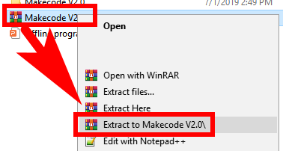
Preparation before class
Part 2
We need to extract Makecode V2.0.rar file, and we will get a Makecode v2.0 folder with Makecode V2.0.exe.
Tip: Extract software is winrar.
Extract
MakeCode？
Yahboom Croco:Kit tutorial

Slide 5
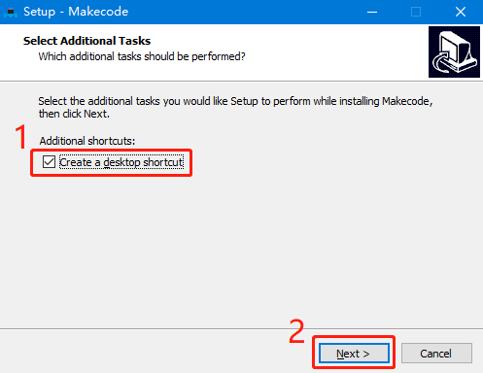
Preparation before class
Part 3
3.1 Double click MakeCode v2.0.exe to install，you will see the interface as shown below. Then, you need to click “Next”.
How to install
MakeCode？
Yahboom Croco:Kit tutorial

Slide 6
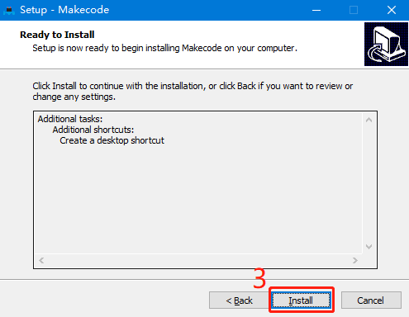
Croco:Kit课前准备视频教程
Part 3
3.2 We need to click “Install”.
How to install
MakeCode？
Yahboom Croco:Kit tutorial

Slide 7

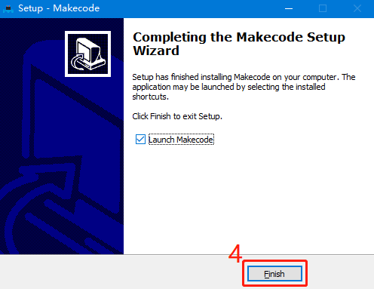
Preparation before class
Part 3
3.3 Wait patiently to complete the installation, we need to click “Finish”. At this
point, the desktop will have an additional icon.
The default installation path is C:\Makecode
How to install
MakeCode？
Yahboom Croco:Kit tutorial

Slide 8
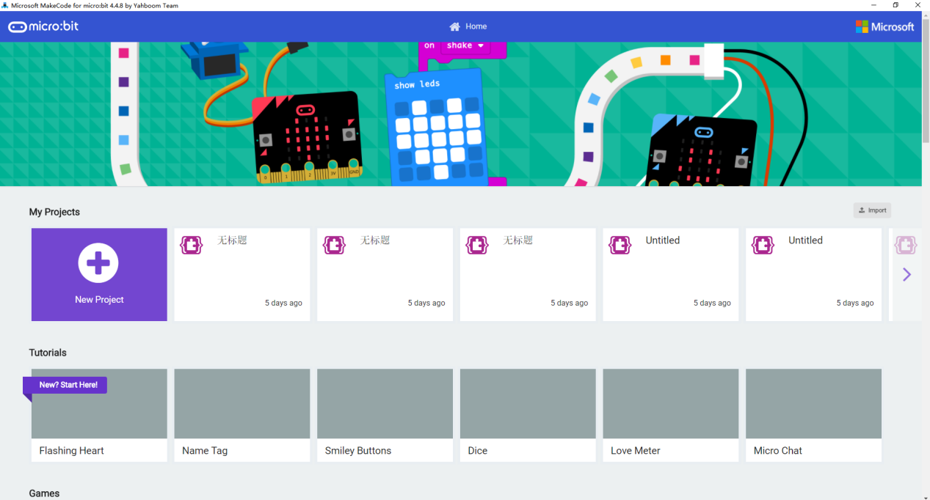
Preparation before class
Part 4
4.1Open a shortcut on your desktop, you can enter the offline programming interface,
How to creat new project？
Yahboom Croco:Kit tutorial

Slide 9
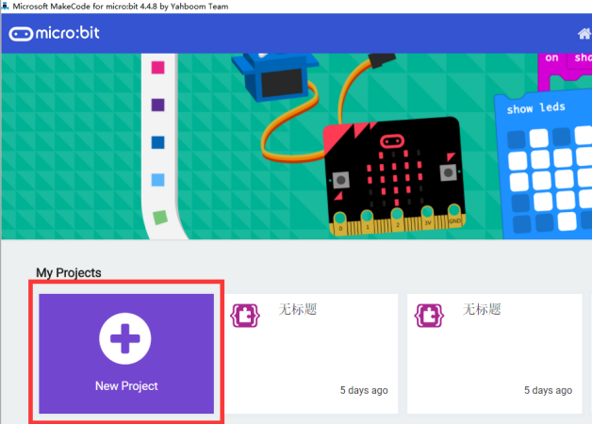
Preparation before class
Part 4
4.2 Click the [New Project] option in the interface to enter the programming page.
Yahboom Croco:Kit tutorial

Slide 10
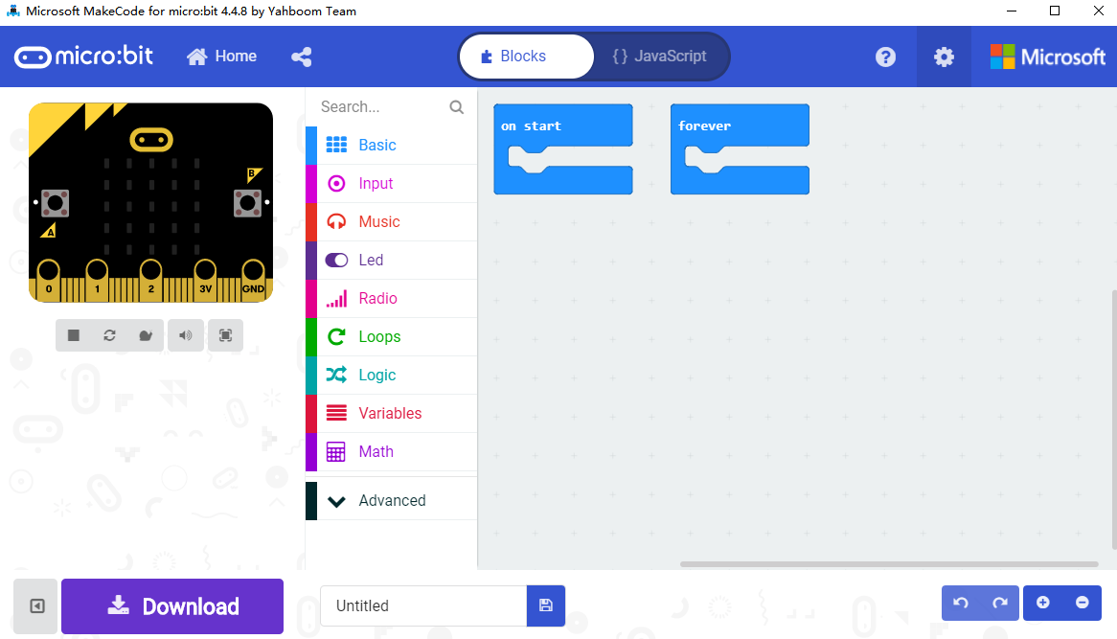
Preparation before class
Part 4
4.3 The interface shown below is the micro:bit offline programming interface we need to use.
Yahboom Croco:Kit tutorial

Slide 11
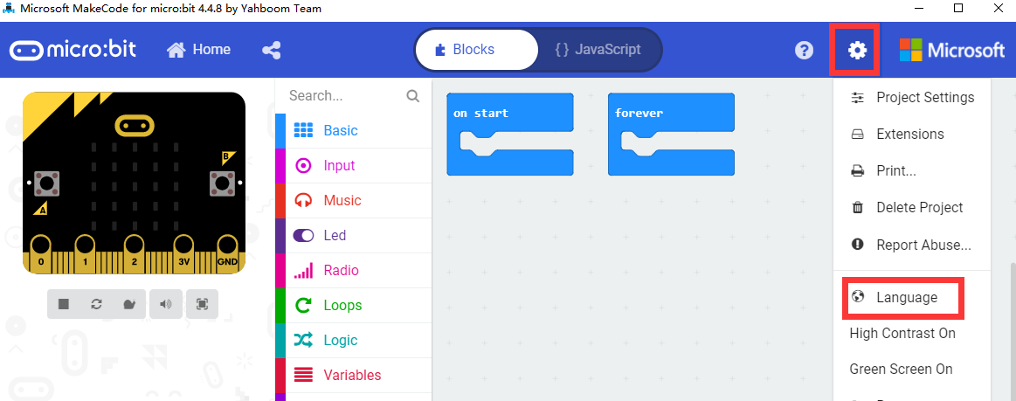
Preparation before class
Part 4
4.4 Click the icon in the upper right corner to switch languages, as shown below.
Yahboom Croco:Kit tutorial

Slide 12
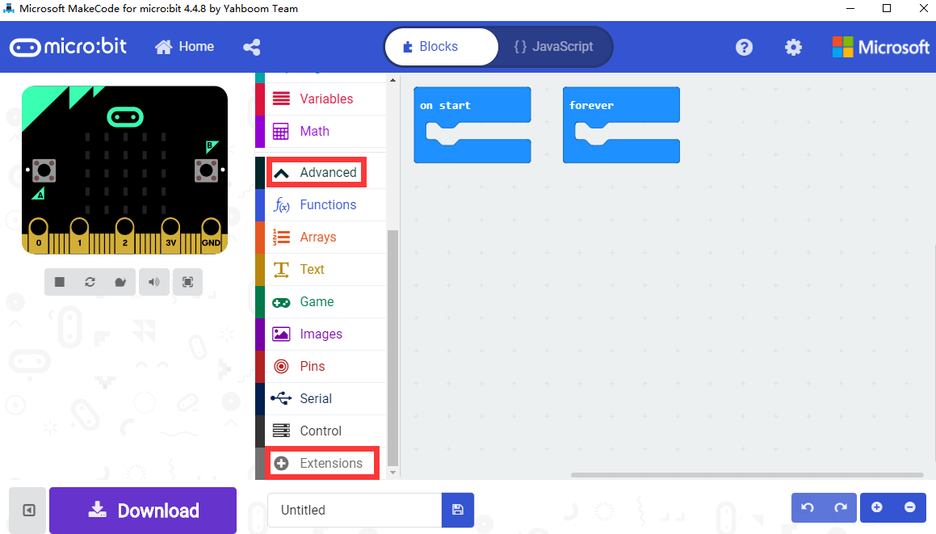
Preparation before class
Part 4
4.5 We first need to add the Yahboom package. In the interface shown in Figure below, click [Advanced], then click [Extensions], an interface will pop up.
Yahboom Croco:Kit tutorial

Slide 13
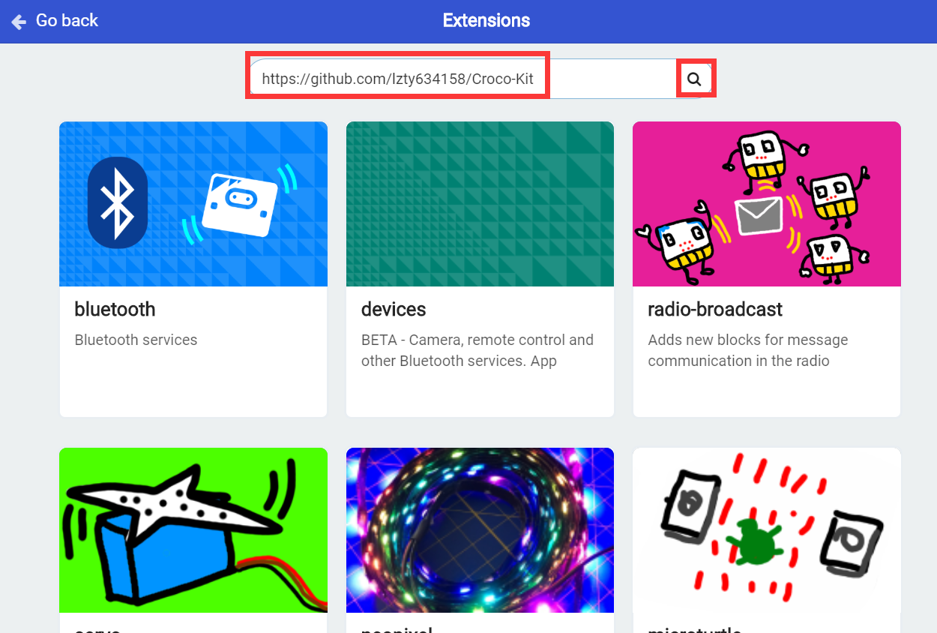
Preparation before class
Part 4
4.6 Enter the URL in the input field: https://github.com/lzty634158/Croco-Kit. Then click "Search" or press the "Enter" key on the keyboard, as shown in Figure below.
Yahboom Croco:Kit tutorial

Slide 14
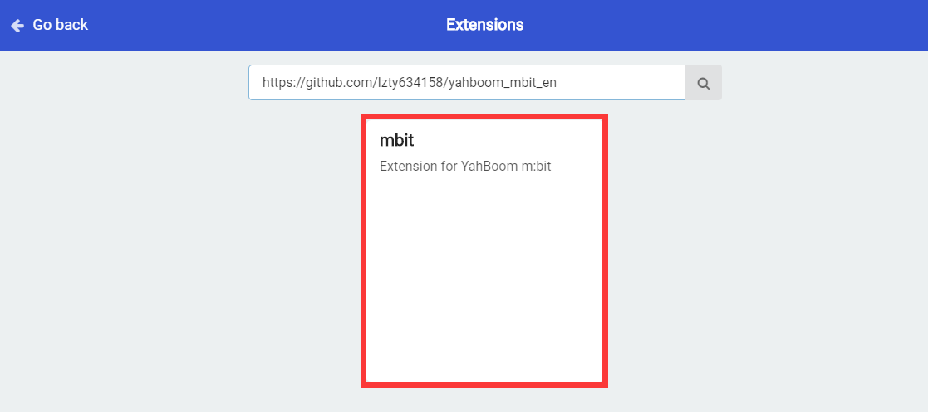
Preparation before class
Part 4
4.7 You can search for the Yahboom software package, and then click mbit, as shown below, you can successfully add the software package.
Yahboom Croco:Kit tutorial

Slide 15
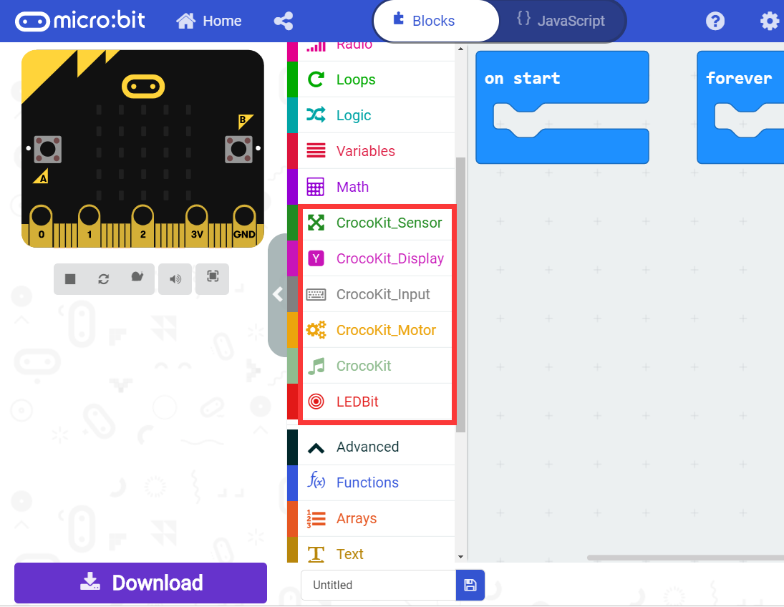
Preparation before class
Part 4
4.8 After loading the package, we can see that the program bar has loaded the building blocks made by Yahboom.
Yahboom Croco:Kit tutorial

Slide 16
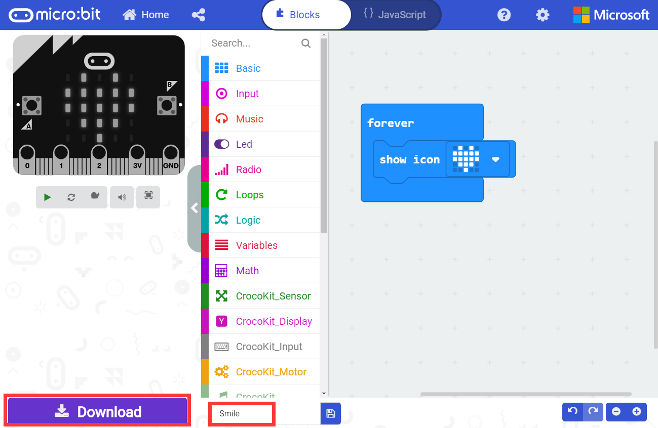
Preparation before class
Part 4
4.9 You can build your own building blocks for programming. After setting up the program blocks, we can name the program ourselves, and then click 【Download】 to download the program, as shown in Figure below. We can set the download path to micro:bit U disk, or directly to the computer, and then copy it to the micro:bit U disk, as shown below.
Yahboom Croco:Kit tutorial

Slide 17
Preparation before class
Thank you !
Powered by
YahBoom
Yahboom Croco:Kit tutorial

